Slide 1
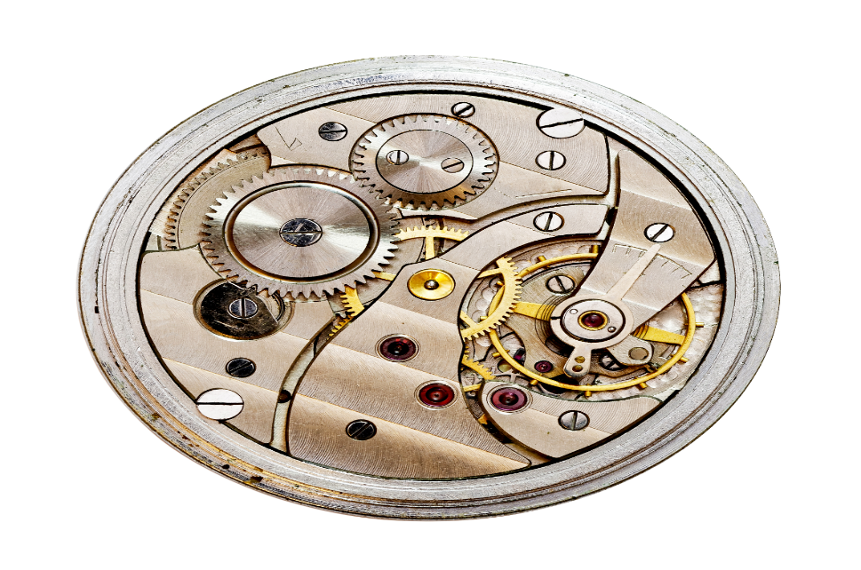
American Modern Insurance Group (AMIG)
ClaimCenter Fraud Analysis and Authorization Review
Deloitte Consulting Proposal
Oct 15, 2018

Slide 2

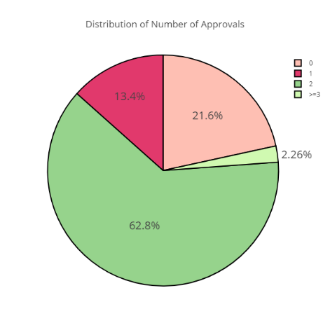
Fraud Scenarios
Number of approvals that a claim goes through
Scenario Detail
Summary of the # of approvals that a claim goes through and the distribution of the same
Method of Analysis
Find the # of approvals each claim has gone through and plot a pie chart of the same to see the distribution
Co-brand Logo
Analysis Results
Maximum (~63%) of the claims go through 2 approvals.
About 22% go through directly by the assigned user/ adjustor.
The % of claims that go through 3 or more users is a marginal ~2.5%

Slide 3
Fraud Scenarios
Manual payments Fraud
Scenario Detail
Manual checks are made without any management approval or with limited approval/sign-off.
Manual checks are deliberately made to the wrong parties.
Method of Analysis
Transactions per claim handler – assuming a similar caseload, any noticeable changes in average transactions (i.e checks cut) can raise a flag.
For every adjuster, compare the count and volume of manual payments made against others for similar cases.
Showcase the count of adjustors in buckets of manual payment % amounts
Named parties in checks and Insured names should be same.
Co-brand Logo
Analysis Results
Only one adjustor in the test data had made manual payment
This manual payment was in the range of 10-15% of the total payments made from that adjustor

Slide 4
Fraud Scenarios
Patterns of historical payments for each adjustor compared to the other adjustors (and this is done by experience level)
Scenario Detail
If in a non-catastrophe scenario, one adjustor has made 100 payments of $150 each for a certain type of accident while the average payment of all other adjustors for such an event is only $50. Then a flag to be raised and investigated further.
Method of Analysis
Compare the payments made by loss type for each adjustor by analyzing their payments distribution.
Compare the payments of each adjustor with the Mean + SD/ Mean + 2SD/ Mean + 3SD of all the adjustors in that cohort to flag the outliers.
(Experience level unavailable in the data hence done it overall).
Co-brand Logo
Analysis Results
Maximum payments by adjustors (above the threshold) have been made for loss Cause ‘Explosion’ and ‘Burn or Scald’
Further deep dive should be done on these as next steps

Slide 5
Fraud Scenarios
Multiple payments to same party/vendor
Scenario Detail
Identify those adjustor/insured combinations where there is a high frequency/ severity of payments made (compared to others for the same adjustor for similar events/ causes)
Adjustor- Receiver fraud Pair
Adjustor- Claimant fraud Pair
Method of Analysis
We rollup the claim payments for each Insured/claimant/Receiver and identify those combinations of Insured/claimant/Receiver – Adjustor that have the highest frequency compared to other adjustors that they have faced.
Then roll that up by adjustor level to see which adjustor has the highest count of customers (for which they have approved the most) against them. Take Mean+SD as the threshold to flag those adjustors above the threshold as compared with the other adjustors.
To be done by adjustor experience level.
Co-brand Logo
Analysis Results

Slide 6
Fraud Scenarios
Advisory Allowance Fraud
Scenario Detail
If the Insured is a general contractor who is working with 3-4 types of subcontractors, adjusters are allowed to bump the claim amount by a certain % as an advisory allowance. There is an abuse in these types of claims.
Method of Analysis
The adjuster is doing it more often than others. Identify this by the frequency distribution of the adjuster’s claimed advisory allowance.
Also check if the adjuster is doing it for a specific insured or small group of insureds (multiple times)
Co-brand Logo
Analysis Results

Slide 7
Fraud Scenarios
Authority level fraud
Scenario Detail
Some adjuster privileges are changed immediately following catastrophes (hurricanes, tornadoes, floods, etc.) that occurred.
Adjuster is behaving differently in handling catastrophe claims which he/she normally wouldn’t do.
Method of Analysis
Compare payment distribution of each adjuster against the other adjusters in that region and see the deviation from their allowance limit
Compare payment distribution by adjuster before and after catastrophe, or prior catastrophes (within a 1-3 year window)
Co-brand Logo
Analysis Results

Slide 8
Fraud Scenarios
Adjuster overpaying the insured than the claimed amount (staying within their authorization limit)
Scenario Detail
If an adjustor has a limit of $500 and an insured claims $300 fro him/her. The adjustor approves a payment of $450 with a fraudulent intention.
Method of Analysis
Find the differences between the claim amount, paid amount and authorization limit for each claim and identify frequent differences.
Assuming the claimed amount from the first reserves setup as the proxy (need to confirm this with Nick).
Co-brand Logo
Analysis Results

Slide 9
Fraud Scenarios
Adjustors with Bad history of frauds (Number of claims guidelines/ rules broken)
Scenario Detail
If there are a lot of complaints/ historical fraud cases against an adjustor – flag to be raised.
Method of Analysis
Check the fraud/ conduct of each adjustor to look for count of fraudulent/ mis-conduct cases for each adjustor. Ones with a high # of mis-conduct historical cases are the one’s to be flagged.
Co-brand Logo
Analysis Results

Slide 10
Fraud Scenarios
Years in company/ Credit score of adjustor and other external variables to be analyzed
Scenario Detail
Reference the external sources of data like EASI/ ISO/ Lexus Nexus etc to find more information about the adjustors and see how they can help predict/ flag their fraudulent cases
Method of Analysis
After pulling in the external information, use them to check for historical fraud.
Co-brand Logo
Analysis Results

Slide 11
Fraud Scenarios
Users(Managers/ Adjusters) changing the Authority Limits Frequently
Scenario Detail
A user/ adjustor changes his/ her authority limit frequently and misuses that
Method of Analysis
Finding users with role as Manager
Keeping Track on the change in Authority limits of the Adjusters
Find users who has access to Change the Authority Limits i.e., Who has role 'User Admin' Assigned to them
Co-brand Logo
Analysis Results

Slide 12
About Deloitte Deloitte refers to one or more of Deloitte Touche Tohmatsu Limited, a UK private company limited by guarantee, and its network of member firms, each of which is a legally separate and independent entity. Please see www.deloitte.com/about for a detailed description of the legal structure of Deloitte Touche Tohmatsu Limited and its member firms. Please see www.deloitte.com/us/about for a detailed description of the legal structure of Deloitte LLP and its subsidiaries. Certain services may not be available to attest clients under the rules and regulations of public accounting.

